Slide 1
Job Performance Analysis
Identifying Key Factors Influencing Employee Performance
By: Tahani Alotaibi

Slide 2
Introduction
The job performance analysis aims to identify and understand the key factors that influence employee performance within the organization. By analyzing various metrics such as the number of projects handled, average monthly hours worked, time spent at the company, and satisfaction levels, we seek to uncover patterns and insights that can help improve overall productivity and efficiency.
Data Source
A comprehensive dataset available on the Kaggle platform was used. This data includes detailed information about employees, including satisfaction level, job performance, the number of projects they are working on, monthly working hours, work accidents, promotions, and different work departments. This data allows us to analyze the factors affecting employee performance in a detailed and comprehensive manner.

Slide 3
Methodology
Analytical Tools and Techniques Used
In this analysis, several analytical tools and techniques were employed to examine the factors influencing employee performance. The analysis was conducted using Python in Google Colab, leveraging various libraries for data manipulation, statistical analysis, and visualization.
1- Data Manipulation:
  Pandas: Used for data cleaning, transformation, and preparation.
  Numpy: Utilized for numerical operations and calculations.
2- Correlation Analysis:
  Pandas Correlation Methods: To identify and measure the strength of relationships between different variables.
  Heatmaps (Plotly): Visual representation of correlation matrices to highlight significant correlations.
3- Hypothesis Testing:
  Scipy Stats: For conducting hypothesis tests such as t-tests to compare means between groups and determine statistical significance.
4- Multiple Regression Analysis:
  Scikit-Learn: Employed for building and evaluating multiple linear regression models to understand the relationship between the dependent variable (performance) and multiple independent variables.
  Statsmodels: Used for detailed statistical analysis and regression diagnostics.
5- Visualization:
  Plotly: Interactive plotting library used for creating interactive and dynamic visualizations, such as scatter plots and bar charts.

Slide 4
Methodology
Explanation of Variables Analyzed
Number of Projects:
  - This variable represents the number of projects an employee is involved in.
  - Analyzed to understand its impact on employee performance.
Average Monthly Hours:
  - Represents the average number of hours an employee works per month.
  - Examined to see how working hours relate to performance evaluations.
Time Spent at the Company:
  - Indicates the number of years an employee has spent at the company.
  - Analyzed to assess its correlation with performance and overall experience.
Satisfaction Level:
  - Reflects the level of satisfaction of the employees.
  - Investigated to determine its impact on performance and retention.
Last Evaluation:
  - Represents the performance evaluation score of an employee.
  Used as the dependent variable in regression models to identify significant predictors of performance.
By using these analytical tools and techniques, the analysis provides a comprehensive understanding of the key factors influencing employee performance, enabling data-driven decisions and strategic improvements.

Slide 5
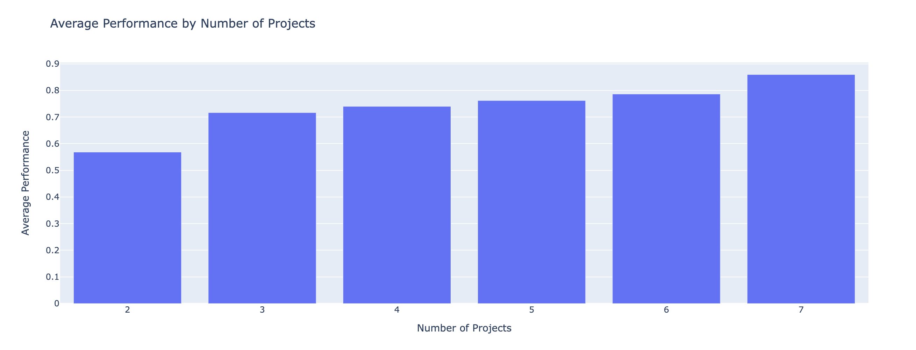
Impact of Number of Projects on Performance
Findings:
- Positive correlation between number of projects and performance
- Statistically significant difference in performance between low and
high project groups
Hypothesis Testing Results:
  T-statistic: -35.14
  P-value: 4.43e-260
  Conclusion: Reject the null hypothesis

Slide 6
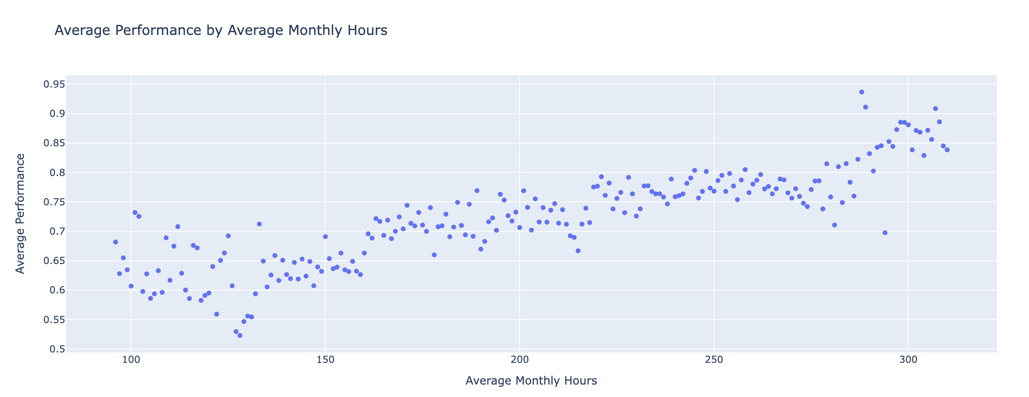
Impact of Average Monthly Hours on Performance
Findings:
- Positive correlation between average monthly hours and
performance
- Statistically significant difference in performance between
low and high hours groups
Hypothesis Testing Results:
  T-statistic: -37.16
  P-value: 3.65e-289
  Conclusion: Reject the null hypothesis

Slide 7
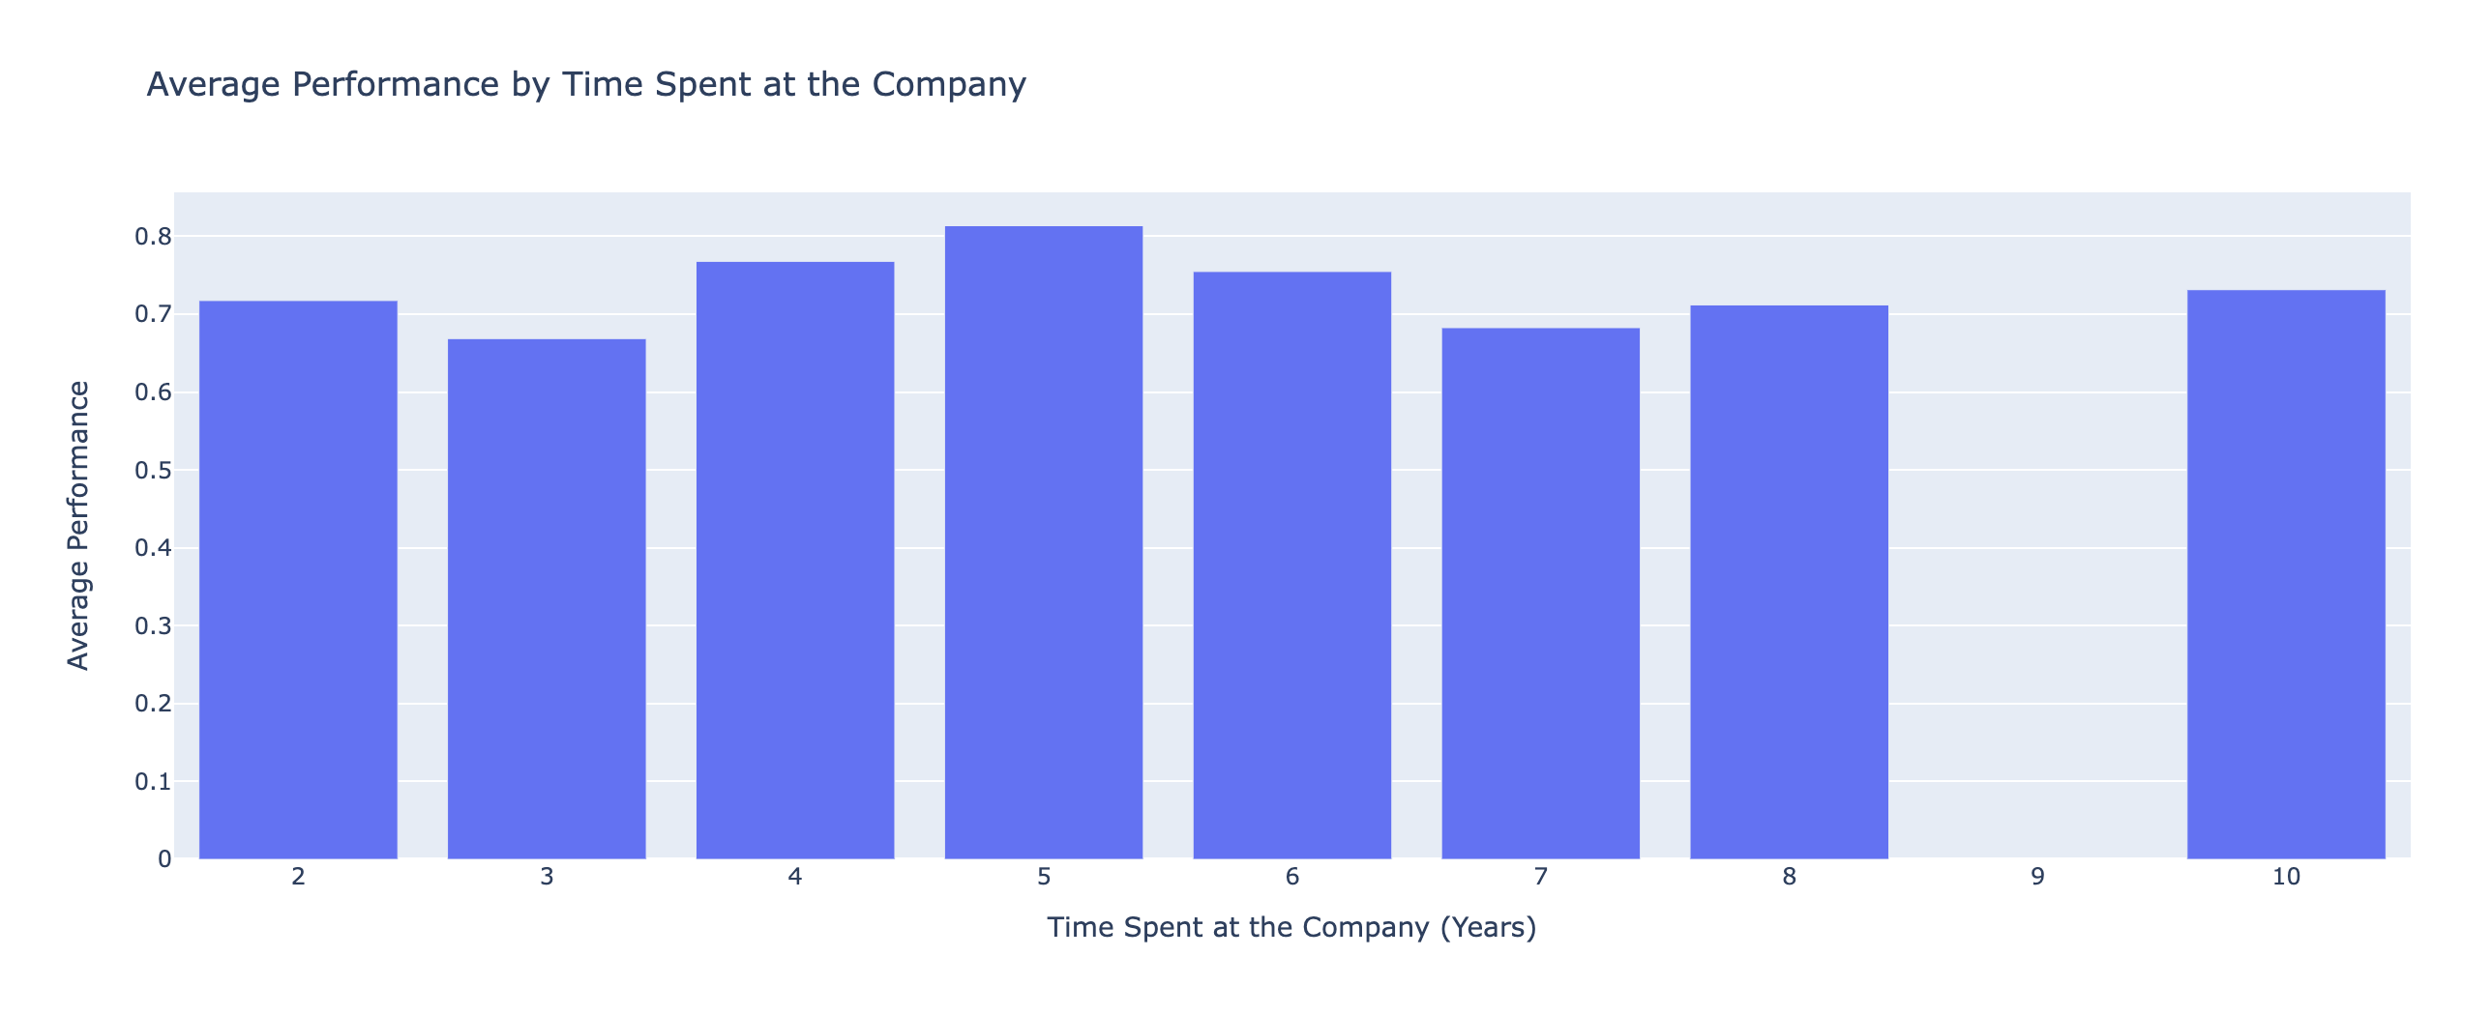
Impact of Time Spent at the Company on Performance
Findings:
- Mixed correlation between time spent at the company and
performance
- Statistically significant difference in performance between
low and high time spent groups
Hypothesis Testing Results:
  T-statistic: -30.90
  P-value: 2.37e-203
  Conclusion: Reject the null hypothesis

Slide 8
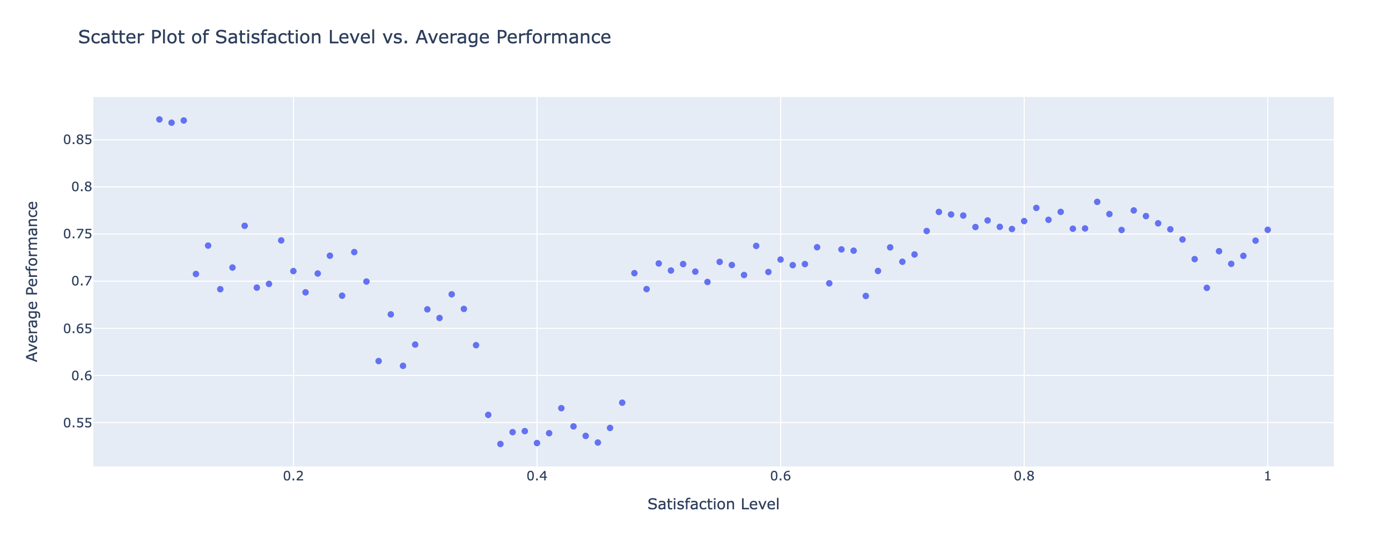
Impact of Satisfaction Level on Performance
Findings:
- Positive correlation between satisfaction level and
performance
- Statistically significant difference in performance between
low and high satisfaction groups
Hypothesis Testing Results:
  T-statistic: -25.24
  P-value: 8.80e-138
  Conclusion: Reject the null hypothesis

Slide 9
Findings
Findings for Job Performance Analysis:
Business Question: What factors most influence employee performance, and how can we enhance these factors to improve productivity?
These findings directly answer the business question by identifying key factors influencing employee performance and providing actionable insights to enhance these factors to improve productivity.
Number of Projects:
  Correlation: A positive correlation (0.35) was found between the number of projects and employee performance. Employees involved in a higher number of projects tend to receive higher performance evaluations.
  Hypothesis Testing: The hypothesis test revealed a statistically significant difference in performance evaluations between employees who work on fewer projects versus those who work on more projects (T-statistic: -35.14, P-value: 4.43e-260).
  Conclusion: Increasing the number of projects assigned to employees could enhance their performance, provided that the workload is manageable.
Average Monthly Hours:
  Correlation: There is a positive correlation between average monthly hours worked and employee performance.
  Hypothesis Testing: The hypothesis test showed a statistically significant difference in performance evaluations between employees who work fewer monthly hours versus those who work more (T-statistic: -37.16, P-value: 3.65e-289).
  Conclusion: Employees who work more hours on average tend to have better performance evaluations. Ensuring employees are engaged for sufficient hours without overworking them can improve performance.

Slide 10
Findings
Findings for Job Performance Analysis:
Business Question: What factors most influence employee performance, and how can we enhance these factors to improve productivity?
3. Time Spent at the Company:
  Correlation: A significant relationship exists between the time spent at the company and employee performance.
  Hypothesis Testing: The hypothesis test indicated a statistically significant difference in performance evaluations between employees with shorter tenures versus those with longer tenures at the company (T-statistic: -30.90, P-value: 2.36e-203).
  Conclusion: Employees with more years at the company generally perform better. Strategies to retain employees longer could lead to improved performance.
4. Satisfaction Level:
  Correlation: There is a positive correlation between employee satisfaction levels and their performance evaluations.
  Hypothesis Testing: The hypothesis test showed a statistically significant difference in performance evaluations between employees with lower satisfaction levels versus those with higher satisfaction levels (T-statistic: -25.24, P-value: 8.80e-138).
  Conclusion: Higher satisfaction levels among employees are associated with better performance. Efforts to improve job satisfaction can lead to enhanced employee performance.

Slide 11
Recommendations
Based on the regression and hypothesis testing results, provide actionable recommendations:
1- Project Management: Balance and manage project assignments
2- Work Hours: Ensure optimal work hours without overburdening employees
3- Retention Strategies: Develop strategies to retain employees longer
4- Satisfaction Programs: Implement programs to enhance employee satisfaction

